Slide 1
Face Detector and Face Morphing
with Principal Component Analysis (PCA)
and Singular Value Decomposition (SVD)

Slide 2
Outline
Application Presentation
Objectives
Literature Review
Theory
Code Explanation – Functionality
Code Explanation – Graphical User Interface
Summary

Slide 3
Application Presentation

Slide 4
Objectives
Implementation and Enhancement of a Face Detection Algorithm using PCA and SVD
Implementation
Implementation of Methodology
Object Oriented Source Code
Enhancement
Implementation an GUI
Implementation a Phase Morph Effect
Displaying the Parameters and their behavior

Slide 5
Literature Review
EigenFaces and A Simple Face Detector with PCA/SVD in Python - by sandipanweb
Principal Component Analysis (PCA) – captures essential features known as eigenfaces
Singular Value Decomposition (SVD) – is a PCA related matrix factorization technique which decomposes data into components aiding in noise reduction and feature extraction
PCA and SVD do not require high computational resources → fast computation

Slide 6
Theory

Slide 7
Code Explanation - Functionality

Slide 8
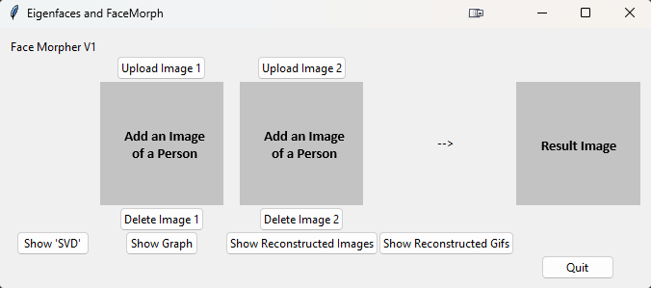
Code Explanation - GUI
1. class UI:
2. # Initialisation
3. def __init__(self, image_processor):
4. self.image1_uploded = False
5. self.image2_uploded = False
6. self.image_processor = image_processor
7. self.root = tk.Tk()
8. self.root.title("Eigenfaces and FaceMorph")
9. self.frm = ttk.Frame(self.root, padding=10)
10. self.frm.grid()
11.
12. # 1st row
13. ttk.Label(self.frm, text="Face Morpher V1").grid(column=0, row=0)
14.
15. # 2nd row
16. ttk.Button(self.frm, text="Upload Image 1", command=self.upload_image1).grid(column=1, row=1)
17. ttk.Button(self.frm, text="Upload Image 2", command=self.upload_image2).grid(column=2, row=1)
18.
19. # 3rd row
20. self.image_blank = ImageTk.PhotoImage(Image.open("blank_image.jpg"))
21. self.image_result = ImageTk.PhotoImage(Image.open("blank_result.jpg"))
22.
23. self.image_label1 = ttk.Label(self.frm, image=self.image_blank)
24. self.image_label1.grid(column= 1, row=2)
25. self.image_label2 = ttk.Label(self.frm, image=self.image_blank)
26. self.image_label2.grid(column= 2, row=2)
27. ttk.Label(self.frm, text="-->").grid(column= 3, row=2)
28. self.image_label3 = ttk.Label(self.frm, image=self.image_result)
29. self.image_label3.grid(column= 4, row=2)
30.
31. # Keep references to avoid garbage collection
32. self.images = {
33. "blank": self.image_blank,
34. "result": self.image_result,
35. "image1": None,
36. "image2": None
37. }
38.
39. # 4th row
40. ttk.Button(self.frm, text="Delete Image 1", command=self.delete_image1).grid(column=1, row=3)
41. ttk.Button(self.frm, text="Delete Image 2", command=self.delete_image2).grid(column=2, row=3)
42.
43. # 5th row
44. ttk.Button(self.frm, text="Show 'SVD'", command=self.show_svd_parameters).grid(column=0, row=4)
45. ttk.Button(self.frm, text="Show Graph", command=self.show_graph).grid(column=1, row=4)
46. ttk.Button(self.frm, text="Show Reconstructed Images", command=self.show_reconstructed_images).grid(column=2, row=4)
47. ttk.Button(self.frm, text="Show Reconstructed Gifs", command=self.show_reconstructed_gifs).grid(column=3, row=4)
48.
49. # 6th row
50. ttk.Button(self.frm, text="Quit", command=self.root.destroy).grid(column=4, row=5)
51.
52.

Slide 9
Summary
Successful importing and processing of images
Successful implementation of functionality
Smooth morphing effect
Simple but easy to use GUI

Slide 10
Thank you for your attention!

Slide 11
Sources
[1] S. Dey, “EigenFaces and A Simple Face Detector with PCA/SVD in Python”, University of Maryland, January 2018
[2] Jolliffe IT, Cadima J. “Principal component analysis: a review and recent developments.” Philos Trans A Math Phys Eng Sci. 2016;374(2065):20150202. doi:10.1098/rsta.2015.0202
[3] Golub, G.H., Reinsch, C. “Singular value decomposition and least squares solutions.” Numer. Math. 14, 403–420 (1970). https://doi.org/10.1007/BF02163027
[4] Jun Zhang, Yong Yan and M. Lades, "Face recognition: eigenface, elastic matching, and neural nets," in Proceedings of the IEEE, vol. 85, no. 9, pp. 1423-1435, Sept. 1997, doi: 10.1109/5.628712
[5] Colmenarez, A.J., Huang, T.S. (1998). Face Detection and Recognition. In: Wechsler, H., Phillips, P.J., Bruce, V., Soulié, F.F., Huang, T.S. (eds) Face Recognition. NATO ASI Series, vol 163. Springer, Berlin, Heidelberg. https://doi.org/10.1007/978-3-642-72201-1_9
[6] J. J. Weng, N. Ahuja and T. S. Huang, "Learning recognition and segmentation of 3-D objects from 2-D images," 1993 (4th) International Conference on Computer Vision, Berlin, Germany, 1993, pp. 121-128, doi: 10.1109/ICCV.1993.378228.

